Slide 1
IMPERFECTIONS IN SOLIDS
Overview of today’s lecture

Slide 2
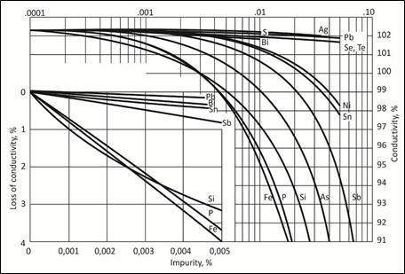
Why do we care about defects?
Many properties may be altered by defects/impurities.
e.g.
Mechanical properties: Metal alloys for improving strength and hardness.
for example: Brass (70% Cu+30% Zn) has higher strength&hardness than pure Cu.
2) Electrical properties:
• Defects and impurities can reduce metal conductivity. (ex: integrated circuits)
• Doping in semiconductors to control of conductivity. (ex: Si)
3) Optical properties:
Wavelengths of light being absorbed and/or emitted by materials can be altered with imperfections.
and many more examples….
Decrease in electrical conductivity of copper in the function of impurity content
http://www.ltpmn.agh.edu.pl/conductivity-app/DATA/cuoverview.html

Slide 3
IMPERFECTIONS IN SOLIDS
It has been assumed that perfect order exists throughout crystalline materials on an atomic scale.
Such an idealized solid does not exist; all contain large numbers of various defects or imperfections.
Crystalline defect : a lattice irregularity having one or more of its dimensions on the order of an atomic diameter.
Classification of crystalline imperfections is frequently made according to geometry or dimensionality of the defect.
Imperfections- Defects by Dimension:
1- Zero dimensional (point defects): vacancies, interstitial atoms, substitutional atoms
2- One dimensional (linear defects): A plane of atoms ends in a line. Dislocations.
3- Two dimensional (planar or area defects): Surfaces and grain boundaries
4- Three dimensional: Second phases.

Slide 4
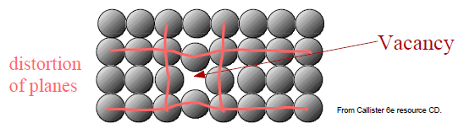
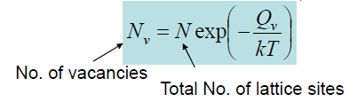
1-Point Defects (Zero dimensional)
1. Vacancies: missing atoms from lattice sites.
All crystalline solids contain vacancies and, in fact, it is not possible to create such a material that is free of these defects.
The presence of vacancies increases the entropy (i.e., the randomness) of the crystal.
Why should vacancies form? explained using principles of thermodynamics.
Consider the energy required to create a vacancy.
Qv = Activation energy to create vacancy
Where does the energy to overcome Qv come from? Thermal Energy!
equilibrium condition:
k = Boltzmann constant
(1.38x10⁻²³ J/atom-K) or (8.62x10⁻⁵ eV/atom-K)
T= Temperature in Kelvin
Nv depends on temperature! & increases exponentially with temperature
For most metals, the fraction of vacancies Nv/N just below the melting temperature is on the order of 10⁻⁴; that is, one lattice site out of 10,000 will be empty.

Slide 5
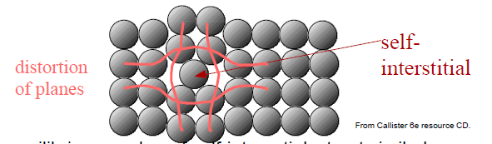
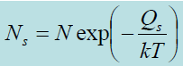
1-Point Defects
2. Self-interstitial: an extra atom (of the same type as the lattice atoms) placed in between lattice sites..
For equilibrium number of self-interstitials: treat similarly as vacancies.
Self-interstitials are usually not as highly probable as vacancies.
Typically, self-interstitial atoms are much larger than interstitial vacancies.
Self-interstitials would likely introduce significantly larger distortions!
The formation of this defect is not highly probable, and it exists in very small concentrations, which are significantly lower than for vacancies. i.e. Qs >> Qv

Slide 6
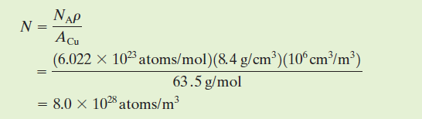
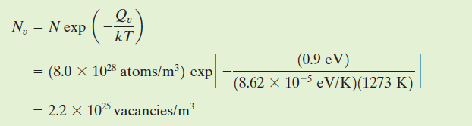
Point defects: example problem:
Calculate the equilibrium number of vacancies per cubic meter for copper at 1000°C. The energy for vacancy formation is 0.9 eV/atom; the atomic weight and density at 1000°C for Cu are 63.5 g/mol and 8.4 g/cm³, respectively.
Solution
it is first necessary to determine the value of N, the number of atomic sites per cubic meter for copper, from its atomic weight A_{Cu}, its density , and Avogadro’s number N_{A}, according to
Thus, the number of vacancies at 1000°C (1273 K) is equal to

Slide 7
1-Point Defects
3. IMPURITIES IN SOLIDS
A pure metal consisting of only one type of atom just isn’t possible; impurity or foreign atoms will always be present, and some will exist as crystalline point defects.
In fact, even with relatively sophisticated techniques, it is difficult to refine metals to a purity in excess of 99.9999 %. At this level, on the order of 10²² to 10²³ impurity atoms will be present in one cubic meter of material.
In the limit of small number of impurities: consider as point defects ( 99.9999% pure).
2. When there is a large amount: consider as solution.
Many familiar materials are highly impure (e.g. metal alloys in which impurity atoms have been added intentionally to impart specific characteristics to the material).
For example, sterling silver is a 92.5 % silver and 7.5% copper alloy. In normal ambient environments, pure silver is highly corrosion resistant, but also very soft. Alloying with copper significantly enhances the mechanical strength without decreasing the corrosion resistance appreciably.
Solid solutions:
Homogeneous distribution of impurities (similar to liquid solutions) with the crystal structure of the host material maintained.
Solvent: element or compound that is in major concentration (host atoms).
Solute: element or compound present in minor concentration (impurity atoms).
depends on the type and concentration of impurity and temperature
→ matrix

Slide 8
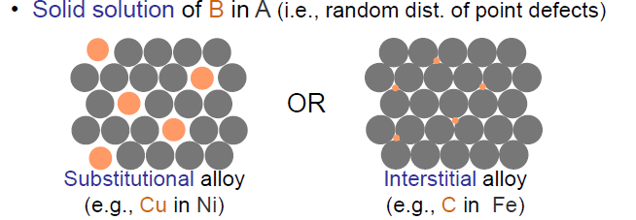
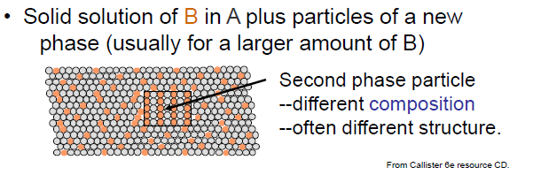
Solid Solutions
A solid solution forms when, as the solute atoms are added to the host material, the crystal structure is maintained and no new structures are formed.
A solid solution is also compositionally homogeneous; the impurity atoms are randomly and uniformly dispersed within the solid. (e.g.: alcohol and water)
Two outcomes if impurity (B) added to host (A):
APF in metals is high
and so interstitial
vacancies are small.
The diameter of interstitial
impurity atoms are much
smaller than that of matrix.
interstitial concentration < 10 %

Slide 9
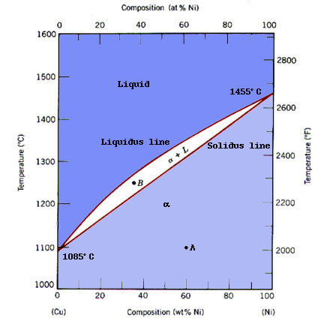
Solubility for solid solutions
1- Solubility of substitutional solution will depend on: (W. Hume – Rothery rules)
1. Atomic size factor: typically, atomic radii difference < 15%. Too large or too small impurity atoms will cause too much lattice distortions!
2. Crystal structure: For appreciable solubility, host and impurity atoms should have the same crystal structure.
3. Electronegativity: It should be close. Too large electronegativity difference will lead to intermetallic compounds rather than solutions.
4. Valence: Same valence is preferred for high solubility.
Example: The substitutional solid solution is found for copper and nickel.
These two elements are completely soluble in one another at all proportions. the atomic radii for copper and nickel are 0.128 and 0.125 nm, respectively; both have the FCC crystal
structure; and their electronegativities are 1.9 and 1.8; finally, the most common valences are 1 for copper (although it sometimes can be 2) and 2 for nickel.
Notes:
Several features of the solute
and solvent atoms determine the degree to which the former dissolves in the latter,
as follows:

Slide 10
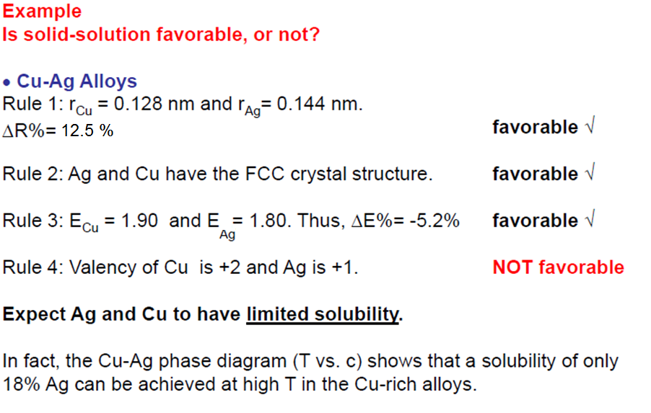
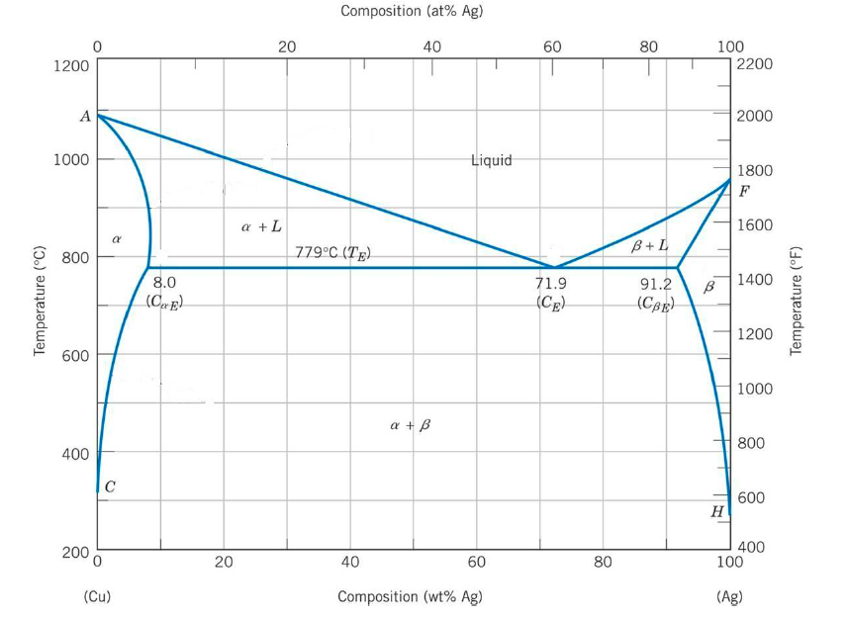

Slide 11
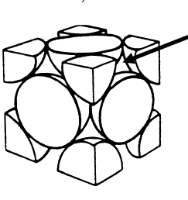
Solubility for solid solutions
2. Interstitial solutions:
Large difference in atomic radii is usually required.
Most metals have close packing with relatively large APF.
(e.g. APF_{FCC} = APF_{HCP} = 0.74. That means 74 % of the space is filled!)
Only small atoms will fit into these small interstitial sites without requiring high energies
e.g. C in Fe ( all types of steels):
R_{C} = 0.071 nm
R_{Fe} = 0.124 nm
Even with this large difference max.
conc. is only ~2 % C in Fe.

Slide 12
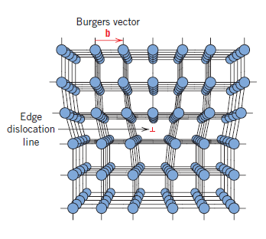
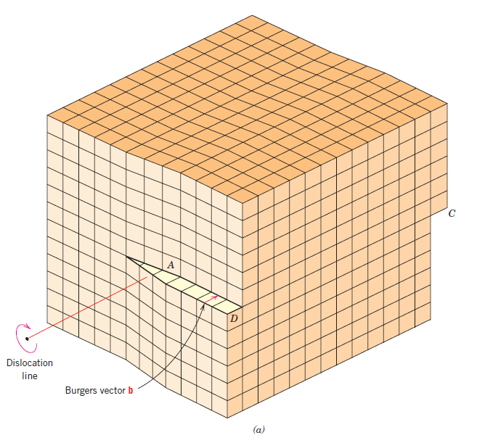
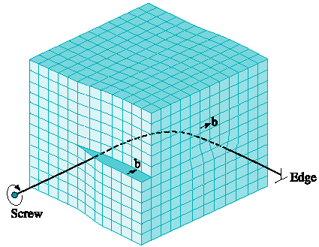
2- Linear defects - Dislocations
Dislocations: Linear defects around which atoms are misaligned
Types of dislocations are:
Edge Dislocation
Screw Dislocation
Mixed Dislocation
Edge Dislocation
Mixed Dislocation
Screw Dislocation

Slide 13
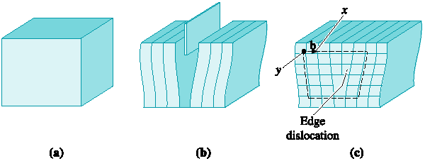
2- Linear defects - Dislocations :
EDGE DISLOCATION
A dislocation introduced into the crystal by adding an ‘‘extra half plane’’ of atoms.
An edge dislocation can be illustrated by slicing partway through a perfect crystal, spreading the crystal apart, and partly filling the cut with an extra plane.
(c)
(a)
(b)
(a)The perfect crystal
(b)The perfect crystal is cut and an extra plane of atoms is inserted
(c)The bottom edge of the extra plane is an edge dislocation
Burgers vector b is required to close a loop of equal atom spacing around the edge dislocation.

Slide 14
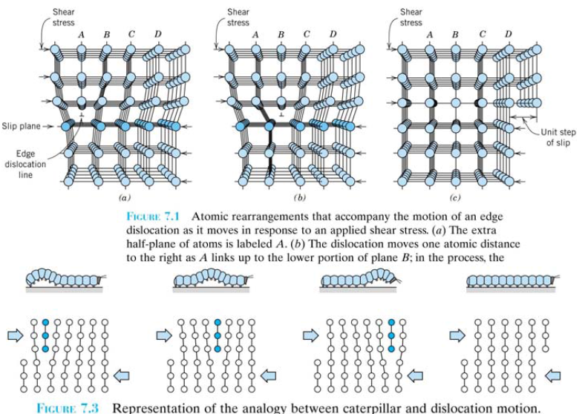
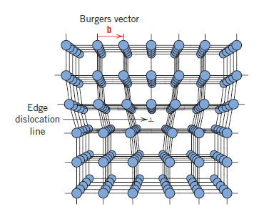
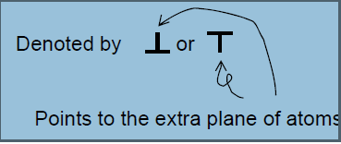
2- Linear defects -Dislocations :
EDGE DISLOCATION
Note that the edge dislocations cause slip between crystal planes when they move leading to plastic (permanent) deformation.

Slide 15
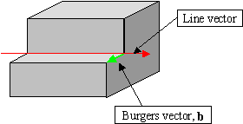
2- Linear defects -Dislocations :
EDGE DISLOCATION
Burgers vector is perpendicular to the edge dislocation.

Slide 16
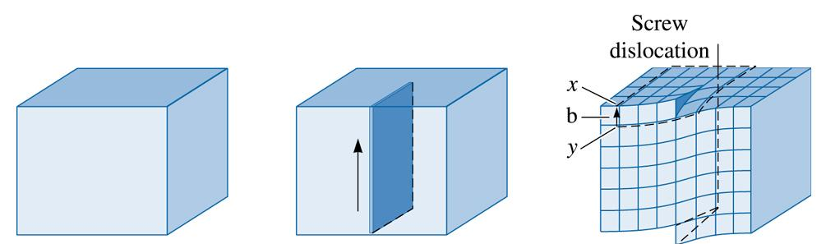
2- Linear defects -Dislocations :
SCREW DISLOCATION
A dislocation produced by skewing a crystal so that one atomic plane produces a spiral ramp about the dislocation.
Screw dislocation can be illustrated by cutting partway through a perfect crystal, then skewing the crystal one atom spacing.
(b) The perfect crystal is cut and sheared one atom spacing
(c) 2003 Brooks/Cole Publishing / Thomson Learning
(a)
The perfect crystal
(c)The line along which shearing occurs is a screw dislocation.
Burgers vector (b) is required to close a loop of equal atom spacing around the screw dislocation.

Slide 17
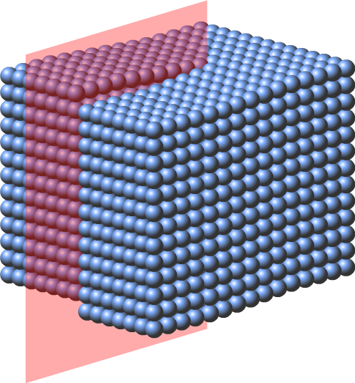
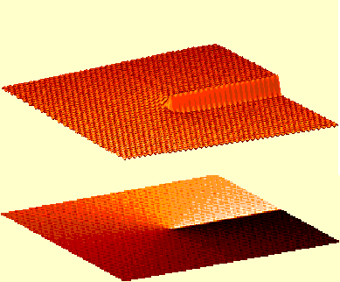
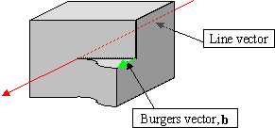
2- Linear defects -Dislocations :
SCREW DISLOCATION
may be thought of as being formed by a shear stress that is applied to produce the distortion
Sometimes the symbol is used to designate a screw dislocation
Burgers vector is parallel to the screw dislocation.

Slide 18
2- Linear defects-Dislocations :
MIXED DISLOCATION
Most dislocations found in crystalline materials are probably neither pure edge nor pure screw, but exhibit components of both types; these are termed mixed dislocations.
A mixed dislocation has both edge and screw components, with a transition region between them.
The Burgers vector remains the same for all portions of the mixed dislocation.
The screw dislocation at the front face of the crystal gradually changes to an edge dislocation at the side of the crystal.

Slide 19
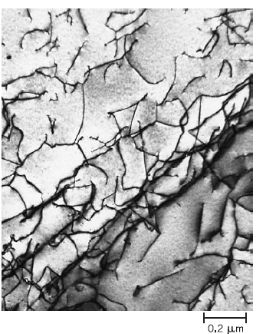
Observing dislocations
A transmission electron micrograph of a titanium alloy in which the dark lines are dislocations. 51,450x.
(Courtesy of M. R. Plichta, Michigan
Technological University.)
In most of the crystalline materials,
dislocations arise from the thermal strains during solidification, rapid cooling or plastic deformation.

Slide 20
3- Planar or Interfacial defects:
Primary defect types:
Surfaces & Interfaces
• Places where reactions occur and materials mix
Grain Boundaries
• Lattices (and so bonds) do not match up
Twins
• Planes shear to change material shape
Stacking Faults
• Errors in stacking (eg: ABCABCABACBACBABCABC)

Slide 21
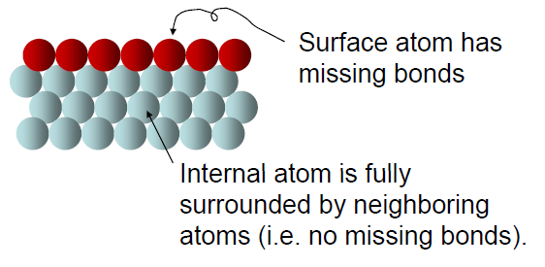

3- Planar or Interfacial defects:
External surface
One of the most obvious boundaries is the external surface
Surface atoms are in higher energy states than internal atoms.
Why?
The bonds of these surface atoms that are not satisfied give rise to a surface energy, expressed in units of energy per unit area (J/m² or erg/cm²).
To reduce this energy, materials tend to minimize the total surface area; not for rigid solids but for liquids.
For example: the droplets become spherical
Notes:
For
example, liquids assume a shape having a minimum area—the droplets become
spherical. Of course, this is not possible with solids, which are mechanically rigid.

Slide 22
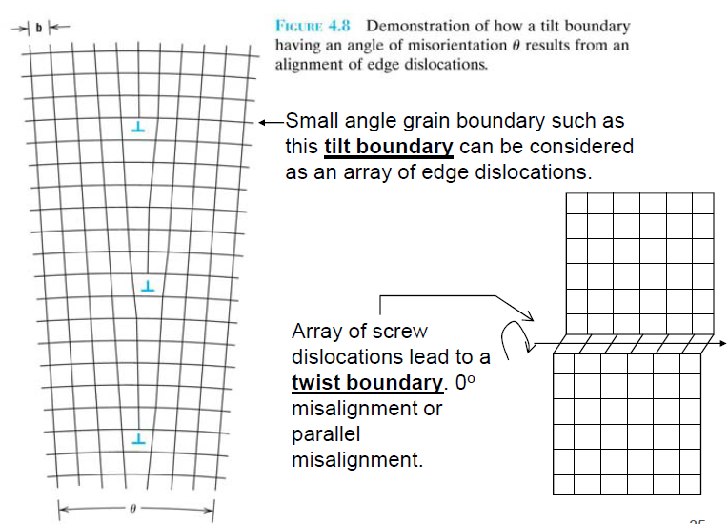
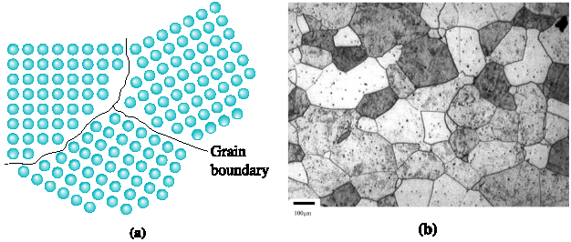
3- Planar or Interfacial defects:
Grain Boundaries
Grain boundary: the boundary separating two small grains or crystals having different crystallographic orientations in polycrystalline materials.
(a) The atoms near the boundaries of the three grains do not have an equilibrium spacing or arrangement. (b) Grains and grain boundaries in a stainless steel sample. (Courtesy Dr. A. Deardo.)

Slide 23
EFFECTS OF GRAIN BOUNDARIES
Changes mechanical properties
• Boundaries are good places for fracture to occur
• Boundaries interrupt the movement of dislocations
Changes in electrical properties
• Good places to scatter electrons or inhibit their movement
Sites for atom diffusion
• Diffusing atoms move more easily in the boundaries
• Some atoms like to sit in the boundaries (weakens them)
• Materials can “creep” which means even metals at high
temperatures can flow like liquids by diffusion, often through
grain boundaries.

Slide 24
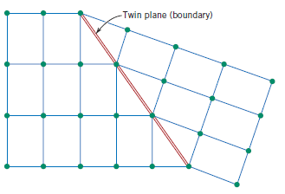
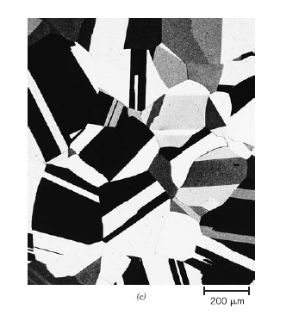
3- Planar or Interfacial defects:
Twin Boundaries
- Special misorientation where atoms on one side of the boundary is the mirror image of the atoms on the other side.
Annealing twins may be observed in the photomicrograph of the polycrystalline brass specimen. 60X.
The region of material between these boundaries is appropriately termed a twin.
Twins result from atomic displacements that are produced from applied mechanical shear forces (mechanical twins), and also during annealing heat treatments following deformation (annealing twins)
Schematic diagram showing a twin plane or boundary and the adjacent atom positions
(colored circles).
Mechanical twins: produced by shear force (in BCC and HCP).
Annealing twins: produced by heat treatment (in FCC).

Slide 25
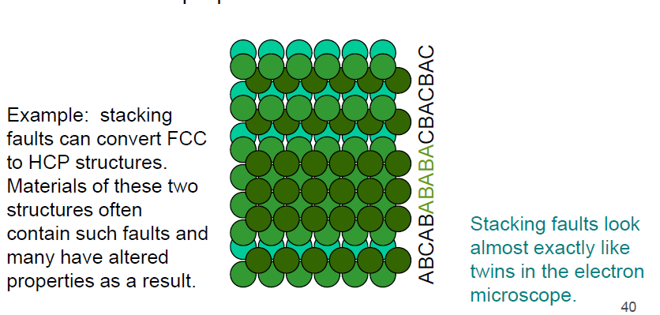
3- Planar or Interfacial defects:
Stacking faults
Any time the stacking sequence of atoms makes a difference an error in stacking of atoms can change the properties of the material

Slide 26
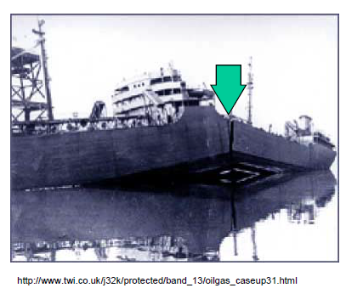
Materials Embrittlement
Oops...
A World-War II liberty ship which broke in half due to poor welds.
The major problem was sulfur impurities in the iron of the weld which caused weak grain boundaries.

Slide 27
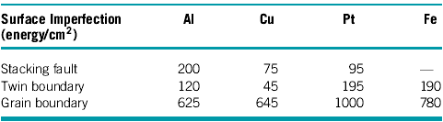


Energies of Imperfections in Selected Metals
The high-energy grain boundaries are much more effective in blocking dislocations than either stacking faults or twin boundaries.

Slide 28
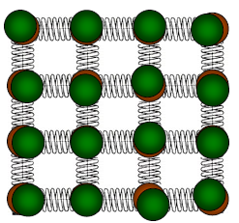
BULK OR VOLUME DEFECTS (Three dimensional )
Other defects exist in all solid materials that are much larger than those discussed up to here.
These include pores, cracks, foreign inclusions, and other phases.
They are normally introduced during processing and fabrication steps.
ATOMIC VIBRATIONS (Three dimensional )
Every atom in a solid material is vibrating very rapidly about its lattice position within the crystal
typical vibration frequency: 10¹³ vibration
typical vibration amplitude: 10⁻³ nm = 10⁻¹²m
In a sense, these atomic vibrations may be thought of as imperfections or defects.
Atomic vibrations have many consequences:
- X-ray peaks are not sharp
- responsible for heat capacity and transport
- melting, when amplitude is high enough
- responsible for electrical resistance

Slide 29
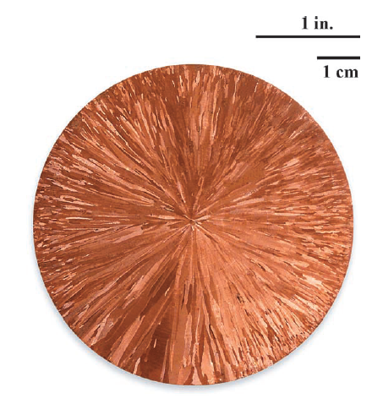
MICROSCOPIC EXAMINATION
It is necessary or desirable to examine the structural elements and defects that influence the properties of materials.
Macroscopic Dimensions: large enough to be observed with the unaided eye.
The shape and average size or diameter of the grains for a polycrystalline specimen.
e.i. Macroscopic grains are often evident on aluminum streetlight posts and on highway guardrails.
Crosssection of a cylindrical copper ingot. The small needle-shaped grains may be observed, which extend from the center radially outward.
Microscopic Dimensions: in most materials the constituent grains are in diameters on the order of microns, and their details must be investigated using some equipments, namely Optical, electron, and scanning probe microscopes.
Microscopic examination is an extremely useful:
-to ensure that the associations between the properties and structure (and defects)
-to predict the properties of materials
-to design alloys with new property combinations
-to determine whether a material has been correctly heat-treated
-to ascertain the mode of mechanical fracture.
Notes:
Some structural elements are of macroscopic dimensions; that is, they are large enough to be observed with the unaided eye. For example, the shape and average size or diameter of the grains for a polycrystalline specimen are important structural characteristics. Macroscopic grains are often evident on aluminum streetlight posts and also on highway guardrails. Relatively large grains having different textures are clearly visible on the surface of the sectioned copper ingot.
Microscopic examination is an extremely useful tool in the study and characterization
of materials. Several important applications of microstructural examinations
are as follows: to ensure that the associations between the properties and structure
(and defects) are properly understood, to predict the properties of materials once
these relationships have been established, to design alloys with new property combinations,
to determine whether a material has been correctly heat-treated, and to
ascertain the mode of mechanical fracture. Several techniques that are commonly
used in such investigations are discussed next.

Slide 30
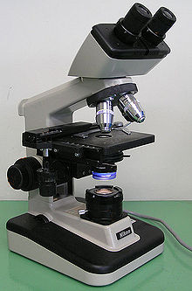
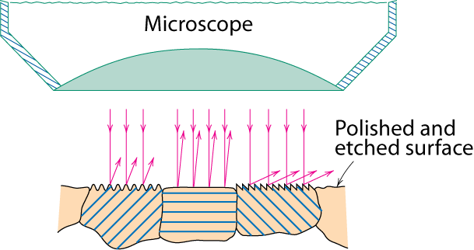
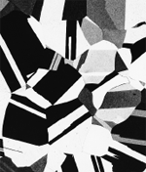
Optical Microscopy (the light microscope)
MICROSCOPIC EXAMINATION
• Investigations of this type are often termed metallographic
Only the surface is subject to observation
Contrasts in the image produced result from differences in reflectivity of the various
regions of the microstructure (Etching changes reflectance, depending on crystalorientation.)
• Careful and meticulous surface preparations are necessary to reveal the important details of the microstructure.
The specimen surface must first be ground and polished to a smooth and mirrorlike finish. The microstructure is revealed by a surface treatment using an appropriate chemical reagent in a procedure termed etching. (The chemical reactivity of the grains depends on crystallographic orientation. )
Useful up to 2000X magnification.
crystallographic planes
Micrograph of
brass (a Cu-Zn alloy)
0.75mm

Slide 31
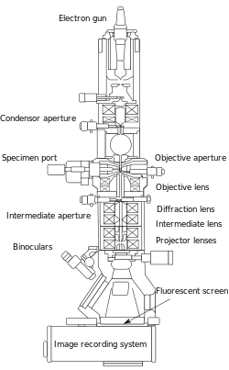
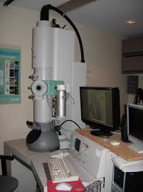
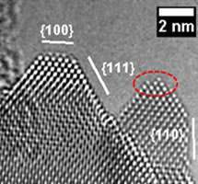
Electron Microscopy
MICROSCOPIC EXAMINATION
Capable of much higher magnifications
An image of the structure under investigation is formed using beams of electrons instead of light radiation.
Types : Transmission Electron Microscopy (TEM) and Scanning Electron Microscopy (SEM)
1-Transmission Electron Microscopy (TEM)
The image is formed by an electron beam that passes through the specimen.
The image are produced by differences in beam scattering or diffraction produced between various elements of the microstructure or defect.
A specimen to be examined must be prepared in the form of a very thin foil.
Magnifications approaching 1,000,000X
Cerium dioxide nanoparticles

Slide 32
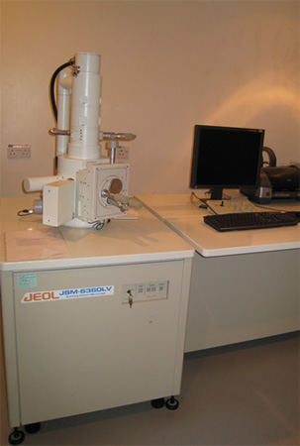
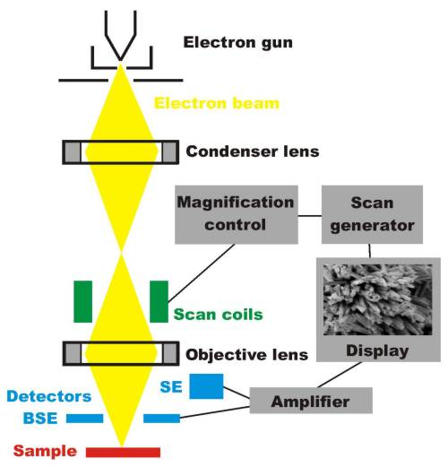
Electron Microscopy
MICROSCOPIC EXAMINATION
2- Scanning Electron Microscopy (SEM)
The surface of a specimen to be examined is scanned with an electron beam, and the reflected (or back-scattered) beam of electrons is collected, to display image.
The surface may or may not be polished and etched, but it must be electrically conductive.
Magnifications approaching 500,000x.
Accessory equipment permits qualitative and semiquantitative analysis of the elemental composition of very localized surface areas.
Schematic representation of a SEM

Slide 33
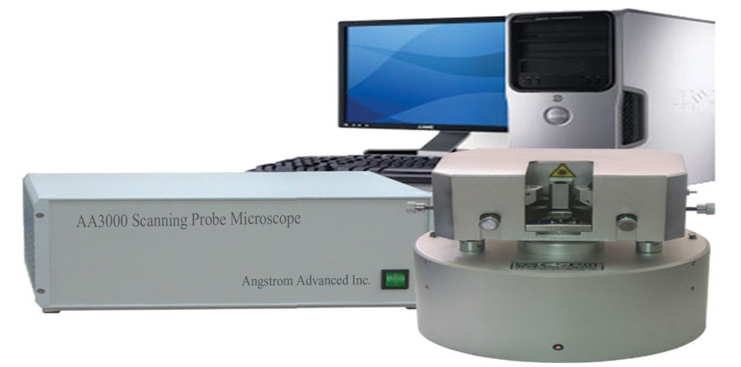
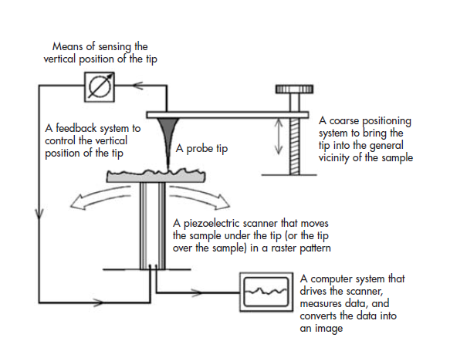
Scanning Probe Microscopy (SPM)
MICROSCOPIC EXAMINATION
Revolutionary, 1980s,
neither light nor electrons are used to form an image. Rather, the microscope generates a topographical map, on an atomic scale, that is a representation of surface features and characteristics of the specimen being examined.
Superiorities:
Examination on the nanometer scale is possible in magnifications as high as 10⁹ are possible; much better resolutions are attainable than with other microscopic techniques.
Three-dimensional magnified images are generated that provide topographical information about features of interest.
Some SPMs may be operated in a variety of environments (e.g., vacuum, air, liquid); thus, a particular specimen may be examined in its most suitable environment.

Slide 34
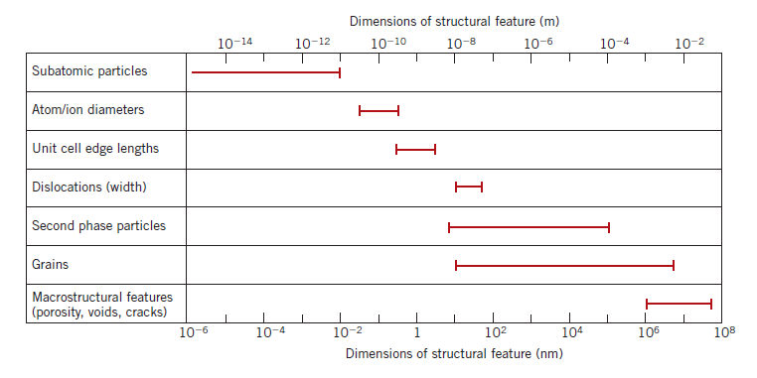
MICROSCOPIC EXAMINATION
Bar chart showing size ranges for several structural features found in materials.
Notes:
(b) Bar chart showing the useful resolution ranges for four microscopic
techniques discussed in this chapter, in addition to the naked eye.

Slide 35
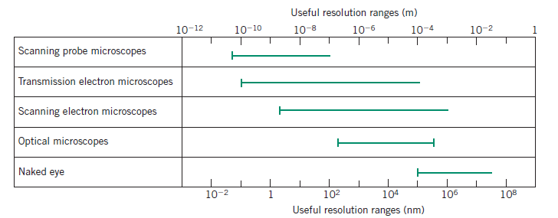
MICROSCOPIC EXAMINATION
Bar chart showing the useful resolution ranges for four microscopic techniques

